Slide 1








SB501 – NAVIGATION SYSTEMS
GEA Tianjin / 中国民航大学中欧航空工程师学院
1 – Radio Propagation Theory
2 – Navaids NDB VOR DME
3 – Landing Systems ILS MLS
4 – Global Navigation GNSS
A. ROUGÉ – ENAC/TA/AVS

Slide 2
INTRODUCTION
VLF: 3 KHz - 30 KHz
LF : 30 KHz - 300 KHz
MF : 300 KHz - 3 MHz
HF : 3 MHz - 30 MHz
VHF: 30 MHz - 300 MHz
UHF: 300 MHz - 3 GHz
SHF: 3 GHz - 30 GHz
6 GNSS
GPS + Augmentations GBAS/SBAS
UHF
3D Position
RALT
AWR
INS
SSR
AZ, SR, Ident, Alt
NDB: Non Directional Beacon
L: Locator
VOR: VHF Omni Range
DME: Distance Measurement
Equipment
ILS: Instrument Landing System
MLS: Microwave Landing System
GPS: Global Positioning System
GR: Ground Radar
SSR: Secondary Surveillance
Radar
RBRG
SR
GR
SR
AZ
QDR
LD
VD
LD VD
NDB/L
LF MF
DME
UHF
GR
SSR
VOR
VHF
LLZVHF
GLI
UHF
MLS
SHF
3 DME
Localiser
Glidepath
1 NDB/L
5 MLS
2 VOR
4 ILS

Slide 3
REFERENCE DIRECTIONS
TN
MN
MD
TN True North
MN Magnetic North
CN Compass North
cv
CN
MD magnetic declination
cv compass variation (compass error)
+
angles are measured clockwise.
TRUE NORTH (TN): Direction from a given location to the north geographic pole.
MAGNETIC NORTH (MN): Direction from a given location to north magnetic pole.
COMPASS NORTH (CN): Direction to north magnetic pole indicated on the compass.
MAGNETIC DECLINATION : angle between True North and Magnetic North. Positive declination if Magnetic North is on the East of the True North. Depends on place and time. Low in France -0°15' Paris 01/01/2012. TH = MH + d.

Slide 4
HEADING - TRACK – DRIFT
North
TR
HDG Heading
TR Track
DA Drift angle
x longitudinal axis
HDG
As air speed
Gs ground speed
DA
HEADING (HDG) : angle between North reference (true or magnetic) and aircraft axis. clockwise. TRUE HEADING and MAGNETIC HEADING.
TRACK (TR): angle between North reference and the ground trajectory of an aircraft.
DRIFT ANGLE (DA) : angle between heading and track.
Track = Heading + DA

Slide 5
RELATIVE BEARING – BEARING
North
BRG
HDG Heading
BRGR Relative Bearing
BRG Bearing
longitudinal axis
HDG
Tx
BRGR
RELATIVE BEARING (BRGR) : angle between aircraft axis and the direction of the point to be measured.
BEARING (BRG) : angle between North reference (true or magnetic) and the direction of the point to be measured.
Bearing = Heading + Relative Bearing

Slide 6
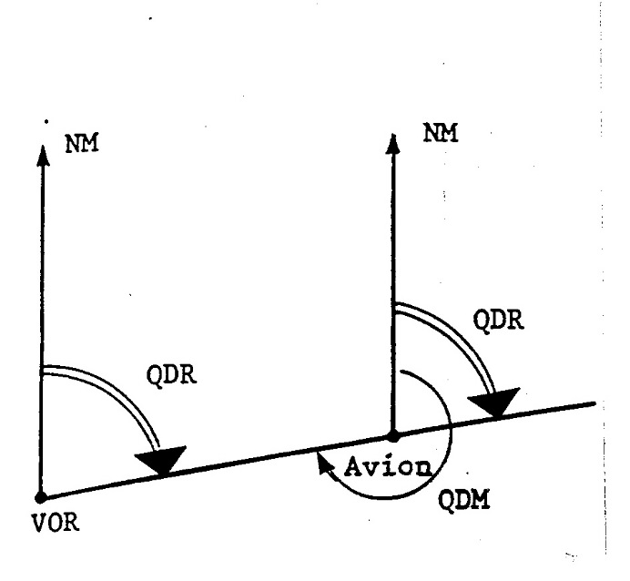
BEARING TO – BEARING FROM
QDM: magnetic bearing to the station
(QUJ: true bearing to the station)
QDR: magnetic bearing from the station
(QTE: true bearing from the station)
NM nautical mile unit of length
1 minute of arc of latitude
measured along a meridian.
1 NM = 1852m = 6076 ft
1 ft = 0.305 m
1 kt = 1 Nm/h = 0.5 m/s
QDM # QDR +/- 180°
QDM = MH + RBRG

Slide 7
GREAT CIRCLE – RHUMB LINE
GREAT CIRCLE (ORTHODROME): shortest distance between two points on the Earth. It is an arc of great circle.
From Paris (Latitude 48°52’ North) to Beijing (Latitude 39°54’ North) common flight route over Baltic Sea.
RHUMB LINE (LOXODROME) : line on the earth’s surface cutting all meridians at the same angle. It is a constant true track. It is not the shortest distance. A straight line on a Mercator chart.

Slide 8
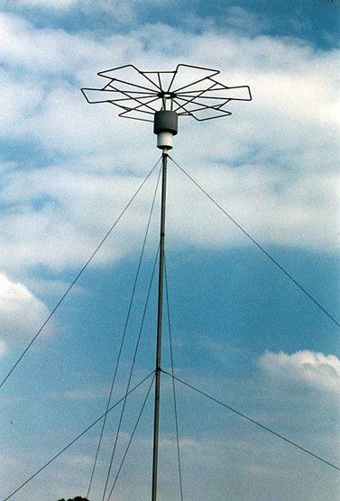
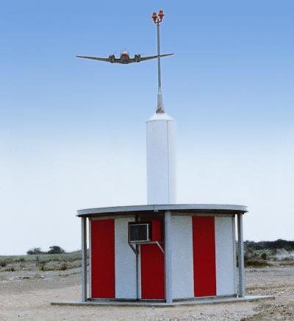
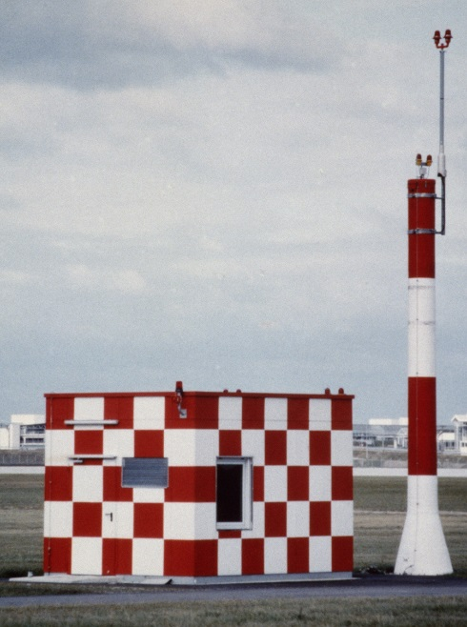
NAVIGATION
DME
DISTANCE
MEASUREMENT
EQUIPMENT
NDB
NON DIRECTIONAL
BEACON
VOR
VHF OMNI RANGE

Slide 9

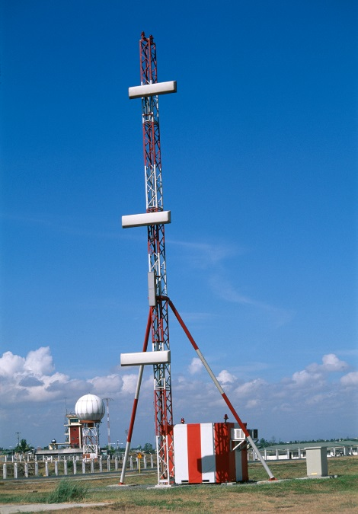
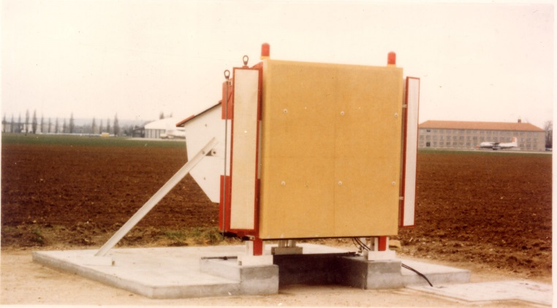
LANDING
ILS
INSTRUMENT LANDING SYSTEM
MLS
MICROWAVE LANDING
SYSTEM
LOCALIZER LLZ
GLIDE GLI

Slide 10
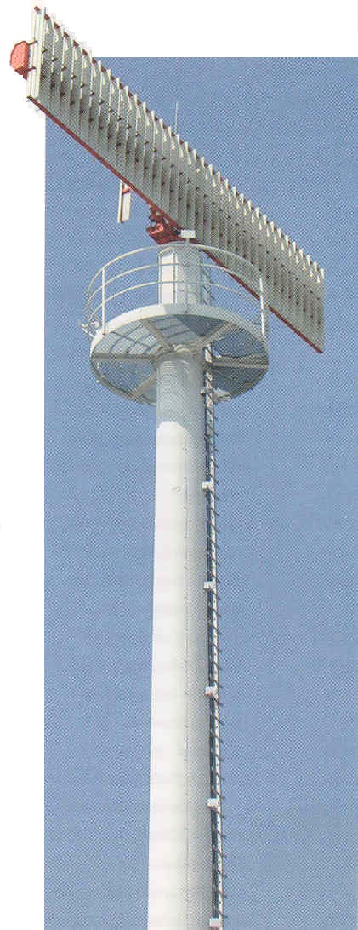
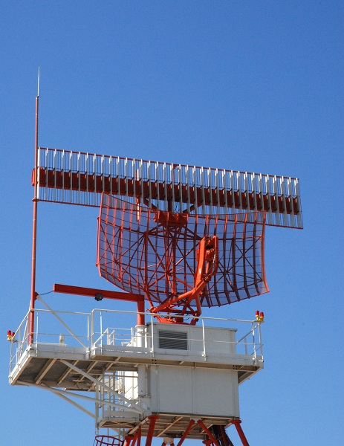
SURVEILLANCE
SSR
SECONDARY
SURVEILLANCE
RADAR
GR
PRIMARY
RADAR

Slide 11
SUMMARY
NDB/L
NDB or Locator ground station beaming an unmodulated carrier.
On-board receiver (ADF Automatic Direction Finder) measuring the emission direction (direction finding) of the received signal. Relative bearing and bearing indicators. Accuracy depends on the conditions of use.
VOR
VOR ground station radiating QDR directly on the carrier.
On-board VOR receiver with bearing and deviation indicators.
Accuracy depends on the quality of the site (nearby obstacles).
DME
DME ground beacon.
On-board DME Interrogator measuring slant range Board / DME Beacon. High Accuracy. Robust system.
INTRODUCTION-<number>

Slide 12
SUMMARY
ILS
Materializes the glide path to the runway threshold.
Intersection of 2 radio planes radiated by 2 radio beacons (Localiser and Glidepath). On-board 2 needles deviation indicator.
Very accurate but narrow guiding sectors.
Sensitive to nearby obstacles.
MLS
Designed to replace the ILS system.
Use of scanning beams.
Very accurate, robust but expensive. Very few facilities.
GPS/GNSS
Global and highly accurate coverage.
Variable precision, low integrity, availability and continuity low.
Need GBAS or SBAS augmentation.
INTRODUCTION-<number>

